Slide 1




IoT
HVAC AIRFLOW MONITORING
Demo Partnerships:
Cloud Platform
Microservices
High Precision
Pressure Sensing
Notes:
,

Slide 2
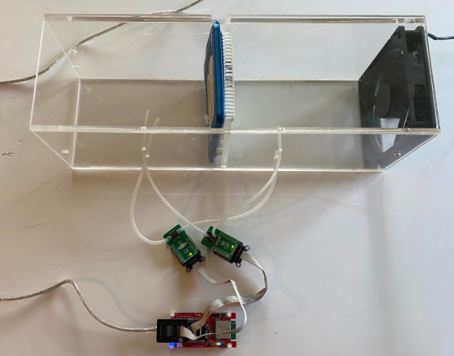
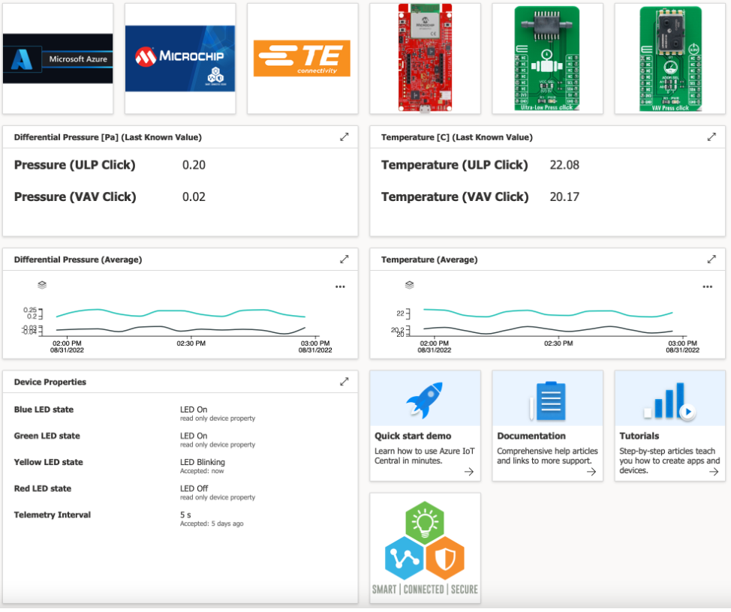

HVAC AIRFLOW MONITORING
Back

